Slide 1
REAL-TIME COLLISION PREVENTION SYSTEM FOR HAIRPIN BENDS USING ESP32-CAM AND OPEN CV
TEAM MEMBERS:
1. SASIDARAN K
2. VISHWA P
3. VELMURUGAN S
GUIDED BY:
Mr. P. MATHESWARAN M.E.,(Ph.D).,

Slide 2
OBJECTIVE
The primary objective of the proposed real-time collision prevention system for hairpin bends is to enhance road safety by detecting and alerting drivers to potential collisions.
Utilizing the ESP32-CAM microcontroller and deep learning models, the system ensures accurate and real-time vehicle detection under various conditions.
Predictive analysis algorithms assess collision risks based on detected vehicle trajectories, enabling timely and meaningful alerts.
The system features a user-friendly interface that provides clear, timely, and non-intrusive warnings, helping drivers take appropriate actions to avoid collisions.

Slide 3
PROBLEM STATEMENT
Hairpin bends on roads present a significant safety challenge due to their sharp turns and limited visibility, often resulting in accidents with severe consequences.
The existing road infrastructure lacks adequate measures to address the specific risks posed by these bends, leading to a pressing need for advanced collision prevention systems tailored specifically for hairpin bends.
The primary problem lies in the lack of real-time detection and alert mechanisms to warn drivers of approaching vehicles from the opposite direction in hairpin bends, where visibility is severely restricted.
Therefore, the problem addressed in this paper is the development of a real-time collision prevention system designed specifically for hairpin bends, aiming to detect potential collision risks and provide timely alerts to drivers to prevent accidents and ensure safer navigation through challenging road conditions..

Slide 4
EXISTING SYSTEM
The existing systems for addressing safety in hairpin bends primarily rely on traditional measures like signage and speed limits.
Some may include basic surveillance cameras, but they lack real-time analysis capabilities.
Advanced driver assistance systems (ADAS) and autonomous vehicle technologies offer some indirect safety benefits, but they aren't tailored specifically for hairpin bends.
Collaborative safety systems using wireless communication exist but may struggle with accurate hazard detection in these challenging road structures.
Overall, there's a need for specialized solutions like the proposed real-time collision prevention system to enhance safety in hairpin bends.

Slide 5
PROPOSED SYSTEM
The proposed real-time collision prevention system for hairpin bends represents a comprehensive approach to enhancing road safety in challenging driving conditions.
This footage is wirelessly transmitted to a processing unit, where advanced algorithms powered by the OpenCV computer vision library analyze the video feed to detect vehicles approaching from the opposite direction.
Its ability to analyze vehicle trajectories and predict potential collision scenarios in real-time provides drivers with crucial information to navigate safely through challenging road conditions.
By combining cutting-edge hardware and intelligent software algorithms, the proposed system offers proactive collision prevention tailored specifically for hairpin bends.

Slide 6
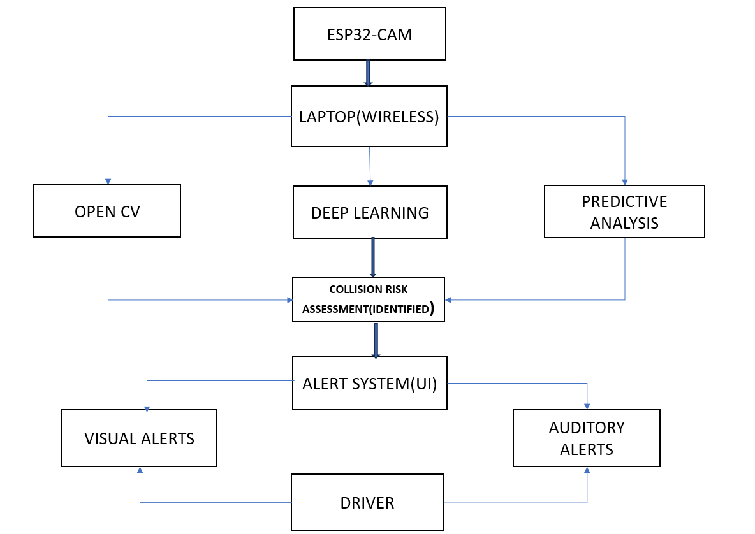
ARCHITECHTURE

Slide 7
MODULE 1 (DATA COLLECTION MODULE AND INTEGRATION MODULE)
This module is responsible for gathering and unifying diverse datasets necessary for training the vehicle detection and collision risk assessment models. Key activities include:
Source Identification: Identify reliable sources of data such as video footage from road surveillance cameras, traffic reports, vehicle movement logs, and weather condition records.
Data Acquisition Implement automated scripts and tools to collect data from identified sources, ensuring adherence to data privacy regulations.
Data Integration Combine data from various sources into a unified dataset, addressing inconsistencies and ensuring data quality.

Slide 8
MODULE 2 (DATA PREPROCESSING MODULE)
The preprocessing module prepares raw data for analysis and modeling by performing the following tasks
Data Cleaning: Remove or correct erroneous entries, handle missing values through imputation or deletion, and ensure data consistency.
Data Transformation: Normalize or standardize numerical features, and encode categorical variables using techniques such as one-hot encoding or label encoding.
Feature Engineering: Create new features from existing data to better capture the underlying patterns relevant to vehicle detection and collision risk assessment.

Slide 9
MODULE 3 (FEATURE SELECTION MODULE)
This module focuses on selecting the most relevant features for the model to improve performance and reduce complexity:
Correlation Analysis: Identify and remove highly correlated features to avoid redundancy.
Principal Component Analysis (PCA): Reduce dimensionality by transforming features into a set of linearly uncorrelated components.
Recursive Feature Elimination (RFE): Iteratively select features by fitting models and removing the least important features.

Slide 10
CONVOLUTIONAL NEURAL NETWORK (CNN)
The Convolutional Neural Network (CNN) is utilized in this project for predicting collision risks at hairpin bends, leveraging its superior capability in image and video analysis.
CNNs are particularly effective for this application due to their layered architecture, consisting of convolutional layers and fully connected layers that synthesize the extracted features for final predictions.
The CNN's ability to automatically learn and extract critical features from raw video footage significantly improves the accuracy and reliability of collision risk predictions, aiding in timely alerts and preventive measures for drivers.
Overall, the CNN enhances road safety by providing real-time, data-driven insights into potential collision risks, ensuring safer navigation through challenging hairpin bends.

Slide 11
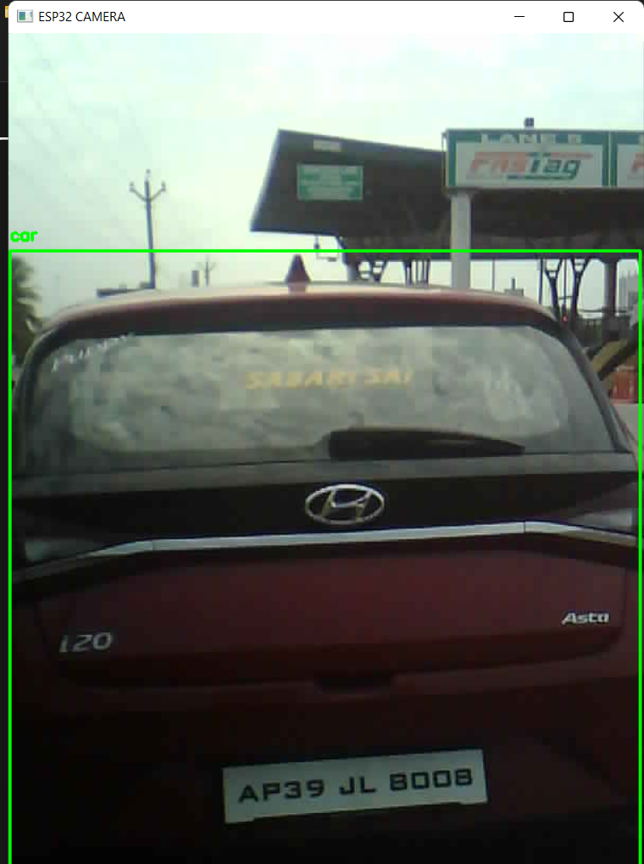

Slide 12
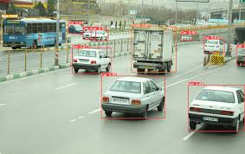
YOU ONLY LOOK ONCE (YOLO)

Slide 13
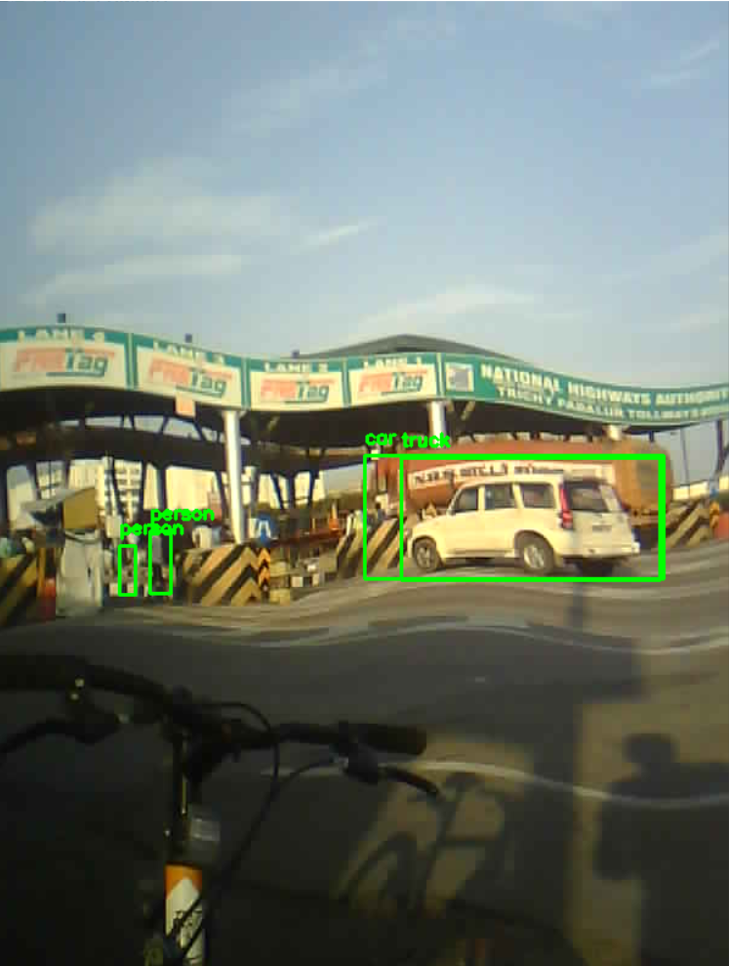
SUPPORT VECTOR MACHINE (SVM)

Slide 14
LITERATURE SURVERY
S.NO | JOURNAL NAME&YEAR | AUTHOR NAME | TITLE | METHODOLOGY | MERITS | DEMERITS
1. | IEEE Conference on Computer Vision and Pattern Recognition (CVPR). | Farhadi, A. (2016). | You Only Look Once: Unified, Real-Time Object Detection. | Object detection in roads . | It is used to detect Objects facing and coming on roads | Object detection is not much clear as possible.
2. | NeurIPS | Girshick.R | R-CNN: Towards Real-Time Object Detection | In Advances in Neural Information Processing Systems | CNN it is used a algorithm and it is so efficient | It efffectness is decreasing due to the object detection phase.

Slide 15
LITERATURE SURVERY
S.NO | JOURNAL NAME&YEAR | AUTHOR NAME | TITLE | METHODOLOGY | MERITS | DEMERITS
3. | Multi-GPU convolution al network (2012) | Krizhevsky .T | GPU clusters | GPU clusters were used to accelerate computing and first time top 5 error rates were lower than existing technologies | Advantage: 15.3 error rate, GPU introduced | Disadvantage: significant performance degrade if network changed
4. | COTS HPC unsupervise d convolution al network (et al., 2013) | Coates. J | COTS | COTS can classify human faces, body(person) and animals requires GPU clusters for multiple days | GPU acceleration efficiently implemented | Classification is limited to certain type of images

Slide 16
LITERATURE SURVERY
S.NO | JOURNAL NAME&YEAR | AUTHOR NAME | TITLE | METHODOLOGY | MERITS | DEMERITS
5. | GoogLeNet 2014 | Szegedy | GoogleNet has 22 layers | GoogleNet has 22 layers, can be re-trained to classify wide range of objects | Optimized computing, scalable, efficient GPU utilization | Designed for competition hence retraining is limited to types of classes in IMAGENET dataset.
6. | Systems(Ma Abadi, Ashish Agarwal, 2015 | K. Sharma, James L. Thompson | machine learning on heterogeneo us systems | Used MLP neural network on 25,000 patients' clinical, genetic, and lifestyle data for multi-cancer detection | Machine learning models is understood visualization tool called TensorBoard. | Applications are practically understanding of mathematical concepts and a other methods are more profound.

Slide 17
THANK YOU…

